Slide 1
Test-Driven Development (TDD) & Pair Programming

Slide 2
Table of Contents
3
What is TDD?
8
Why TDD & Pair Programming are a Perfect Combination?
4
Benefit of TDD
9
Questions?
5
What is Pair Programming?
10
Practice Together
6
Styles of Pair Programming
7
Benefit of Pair Programming

Slide 3
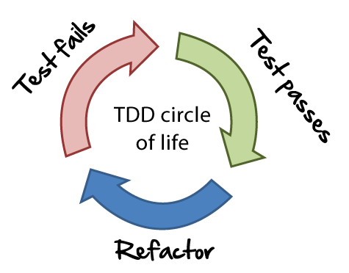
What is Test-Driven Development (TDD)?
Test-Driven Development (TDD) & Pair Programming
What is Test-Driven Development (TDD)?
TDD is a software development practice where developers write tests before writing the actual code.
The process follows a "Red-Green-Refactor" cycle: first, a failing test is written (Red), then minimal code is added to pass the test (Green), and finally, the code is cleaned up and improved without changing its behavior (Refactor).

Slide 4
Benefit of TDD
Test-Driven Development (TDD) & Pair Programming
Benefit of TDD
Improves code quality
Finds bugs early
Makes code easier to change
Clarifies what the code should do
Speeds up fixing problems
Helps design better, cleaner code

Slide 5
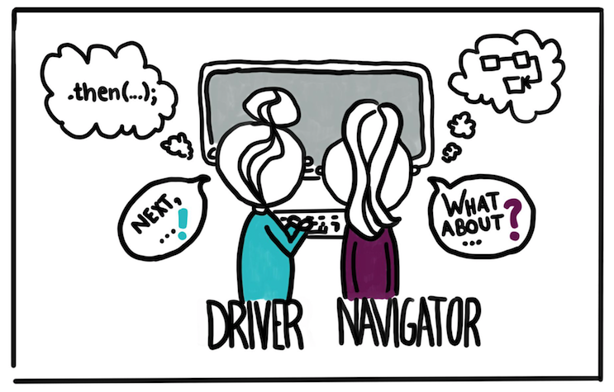
What is Pair Programming
Test-Driven Development (TDD) & Pair Programming
What Is Pair Programming?
Pair programming is a software development technique where two programmers work together at one workstation. One person is the Driver, who writes the code, while the other is the Observer or Navigator, who reviews each line of code as it’s typed, thinking about the bigger picture, catching mistakes, and suggesting improvements. They switch roles often to keep both people engaged

Slide 6
Styles of Pair Programming
Test-Driven Development (TDD) & Pair Programming
Styles of Pair Programming
Driver-Navigator: One types (Driver), one thinks and guides (Navigator).
Ping-Pong: One writes a test, the other writes code to pass it, then switch.
Strong-Style: Ideas must be spoken out loud; the Driver only types what the Navigator says.

Slide 7
Benefit of Pair Programming
Test-Driven Development (TDD) & Pair Programming
Benefit of Pair Programming
Builds better team bonding & communication
Shares knowledge between team members
Makes learning easier for beginners
Catches mistakes early
Improves code quality
Helps solve problems faster

Slide 8
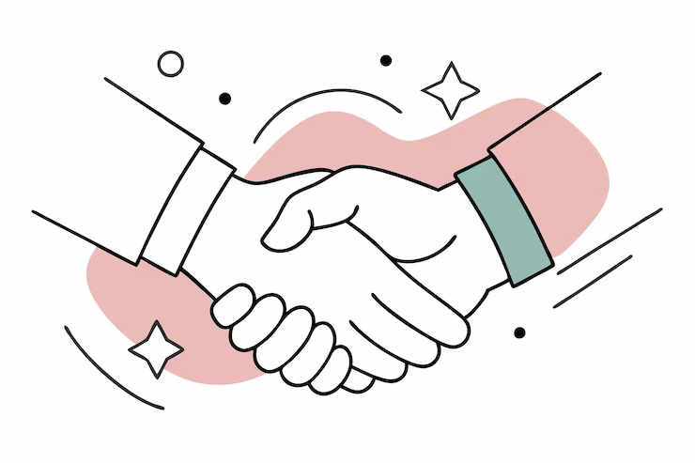
Why TDD & Pair Programming are a Perfect Combination?
Test-Driven Development (TDD) & Pair Programming
Why TDD & Pair Programming are a Perfect Combination?
TDD and pair programming are a perfect combination because TDD forces you to think carefully about what the code should do, and pair programming adds two brains to that thinking. One person can focus on writing tests and thinking about behavior (Navigator), while the other writes the code to pass the tests (Driver). They keep each other on track, catch mistakes early, and design cleaner, more reliable code. Together, they move faster, learn from each other, and build better software with fewer bugs.

Slide 9
🙋🏻‍♂️ Questions? 🙋🏻‍♀️
Test-Driven Development (TDD) & Pair Programming
Questions?

Slide 10
Practice Together 🙌🏻
Test-Driven Development (TDD) & Pair Programming
Practice Together

Slide 11
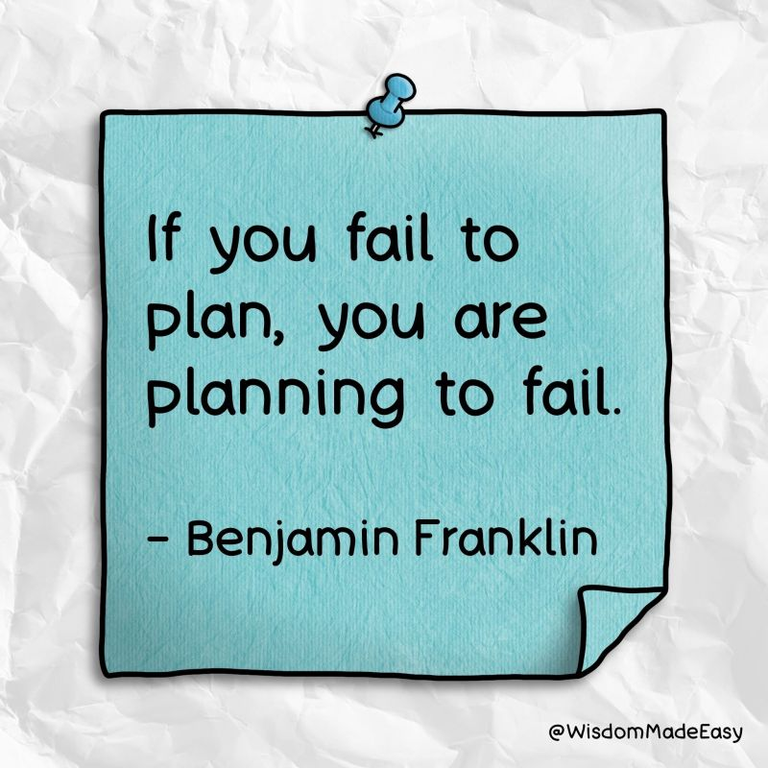
Test-Driven Development (TDD) & Pair Programming
Quote of the Day

Slide 12
Thank You 🙏🏻
Test-Driven Development (TDD) & Pair Programming
Practice Together

